Slide 1

In Consumer Reviews We Trust: Decision Making with Sentiment Analysis and Machine Learning
Danny Arenson
08/15/17

Slide 2
Introduction
As consumers, we live in a day and age where everyone seems to have a voice or an opinion, where no product or business is off limits (Yelp, Airbnb, Amazon, etc…)
A company like Amazon has built its platform on encouraging its customers to rate and review their products in order to inform the consumer of what they are getting themselves into.
With very little restriction, the consumer can express his/her own experience with text through a star rating system, corresponding to the positive or negative experience.

Slide 3
The Problem
Reviews are constantly increasing
People have different needs and conditions
How to explore sentiment within reviews
Comprehensive understanding of reviews

Slide 4
The Approach
Deciding which variables have the strongest association to the review classification model.
Breaking reviews into sentences while mapping categories and sentiment.
Implementation of Count Vectorization & Term Frequency Inverse Document Frequency (TF-IDF) on the dataset.
Implementation of Count Vectorization & Term Frequency Inverse Document Frequency (TF-IDF) on the dataset.
Processing textual data through assigning a polarity score for both positive and negative reviews for each product, based on the type of vocabulary associated with each review.
Data
Features
Models
Predictions
Application

Slide 5
Data
~296,000 Amazon product reviews.
Sports and Outdoors reviews are in a compressed JSON gz file.

Slide 6
Wrangling
Removing all stop words helps with analyzing sentiment in a further concise manner.
Revised product review data frame and used a natural language toolkit (Nltk) package, called Tokenize to create a new column "tokenizing" each word in its isolated form.
Created a binary classifier in a new column solely to assess whether the review was deemed "Positive" or "Negative" based on star rating.
What constitutes a positive negative column is where positive review (4-5) are 1 and negative reviews (1-3) are 0.

Slide 7
Data Preprocessing
Preprocessing natural language processing (NLP) data can be time consuming and certain decisions need to be made such as: Should I remove stop words? Do you remove capitalization? How to handle contractions?
I ultimately decided to remove stop words, capitalization, and punctuation, implementing lemmatization and stemming since it made the data easier to work with.
This made my data a bag of words which means that the order of the words were no longer preserved.

Slide 8
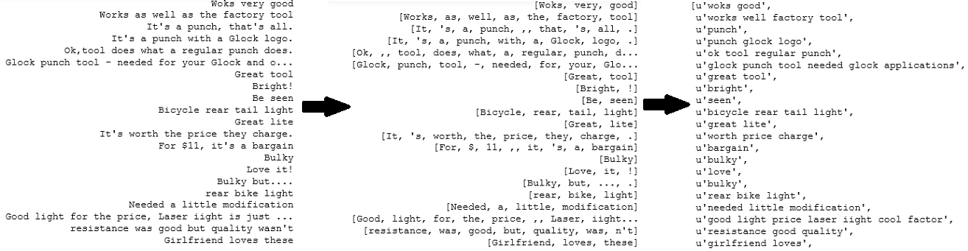
Data Preprocessing cont…
Figure 1: Review data that was converted from original text to text with no “stopwords”, then to text with “bag of words”

Slide 9
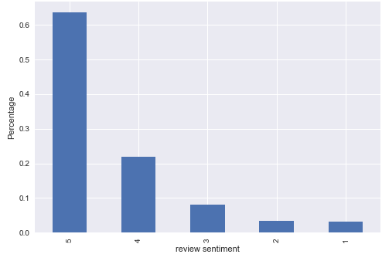
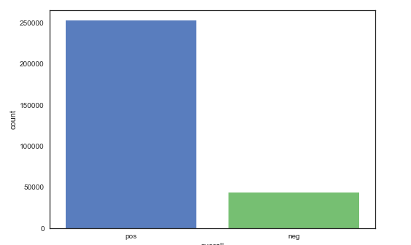
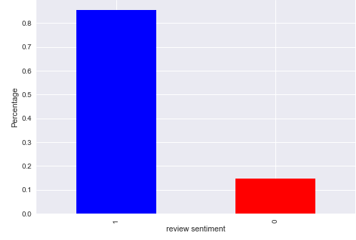
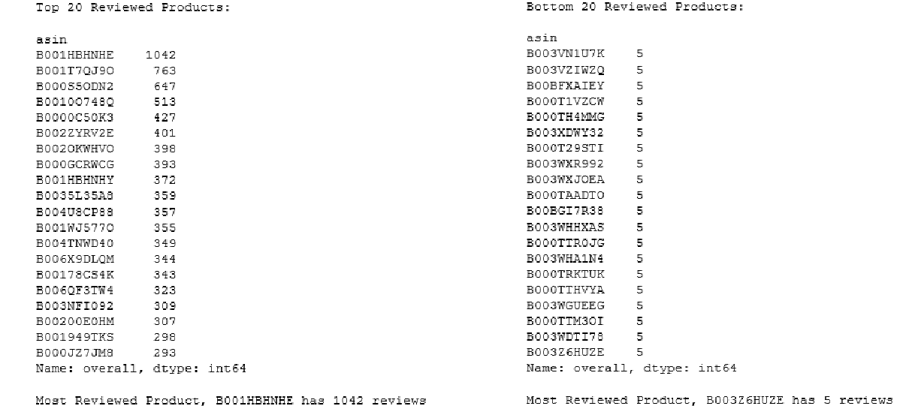
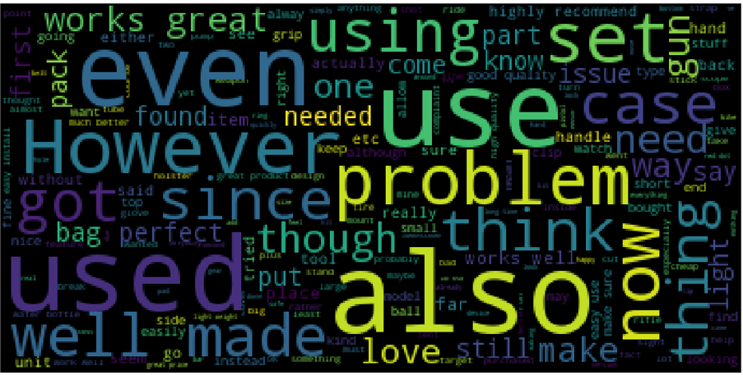
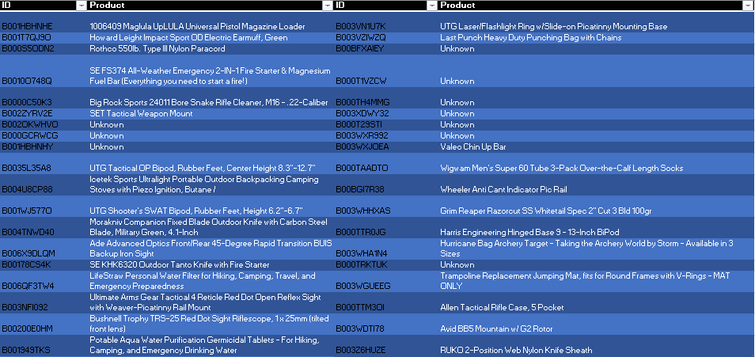
Exploratory Data Analysis
Figure 2: Average Ratings converted to positive and negative binary classifiers
Figure 3 top words used based on wordcloud
Figure 4: Top 20 Reviews, Bottom 20 Reviews

Slide 10
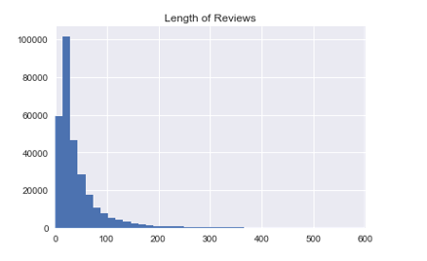
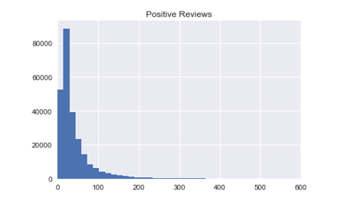
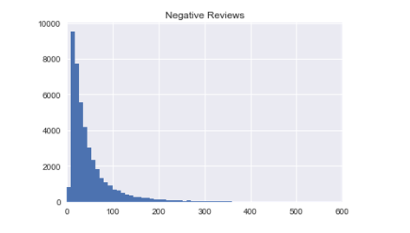
EDA cont...

Slide 11
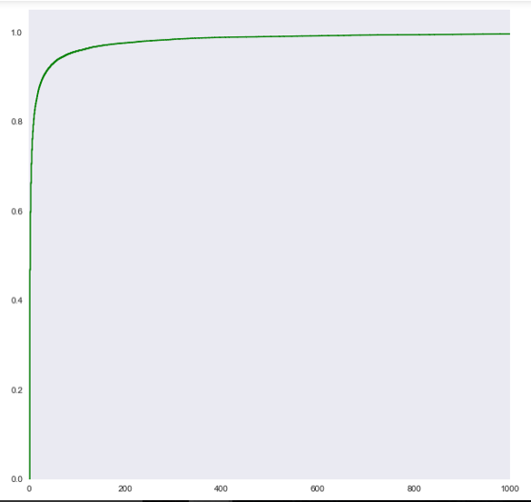
Variable Selection
Subset of features to optimize performance, “Overall” and “Summary”
Term Frequency Inverse Document Frequency (TF-IDF) technique to demonstrate numerical value, how important a word is to a collection of a corpus
The frequency percentage to document count and examined where the minimum document frequency was plotted

Slide 12
Models
Bernoulli NB
Multinomial NB
Decision Tree
Random Forest
Perceptron
Linear Regression
ADA Boost

Slide 13
Results
Classifier | Recall | Precision | F-1 Score
Bernoulli Naïve Bayes | 0.92 | 0.87 | 0.43
Multinomial Naïve Bayes | 0.95 | 0.88 | 0.91
Ada Boost | 0.94 | 0.88 | 0.90
Logistic Regression | 0.93 | 0.89 | 0.90
Decision Tree | 0.92 | 0.88 | 0.89
Random Forest | 0.92 | 0.89 | 0.90
Perceptron | 0.85 | 0.84 | 0.84
Classifier | Split | Accuracy
Bernoulli NB | Train | 88%
 | Test | 87%
Multinomial NB | Train | 89%
 | Test | 88%
Ada Boost | Train | 88%
 | Test | 88%
Logistic Regression | Train | 89%
 | Test | 89%
Decision Tree | Train | 92%
 | Test | 88%
Random Forest | Train | 96%
 | Test | 89%
Perceptron | Train | 84%
 | Test | 84%
Classifier | Area Under the Curve (AUC)
Bernoulli NB | 0.64
Multinomial NB | 0.63
Ada Boost | 0.65
Logistic Regression | 0.67
Decision Tree | 0.66
Random Forest | 0.68
Perceptron | 0.65

Slide 14
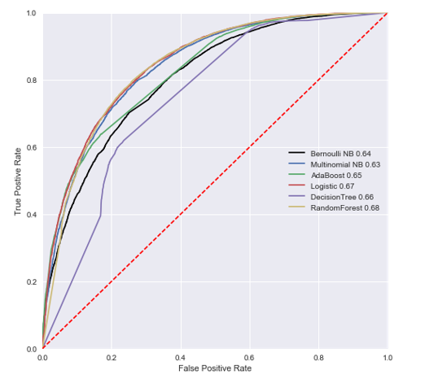
ROC Curve
(The optimal performance classifier)

Slide 15
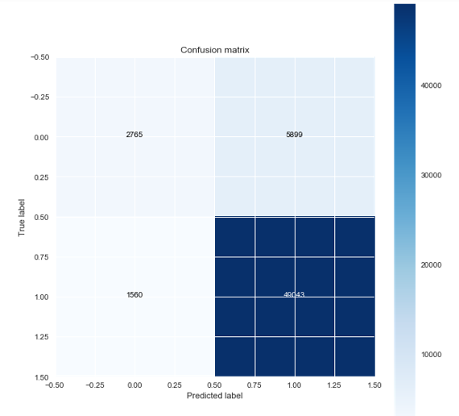
Bernoulli NB
Accuracy: 87.4
Misclassification Rate: 12.6
TP Rate: 96.9
FP Rate: 68.1
Specificity: 31.9
Precision: 89.3
Prevalence: 85.4
Figure 7: TN, FP, FN, TP (clockwise): 2765, 5899, 1560, 49043

Slide 16
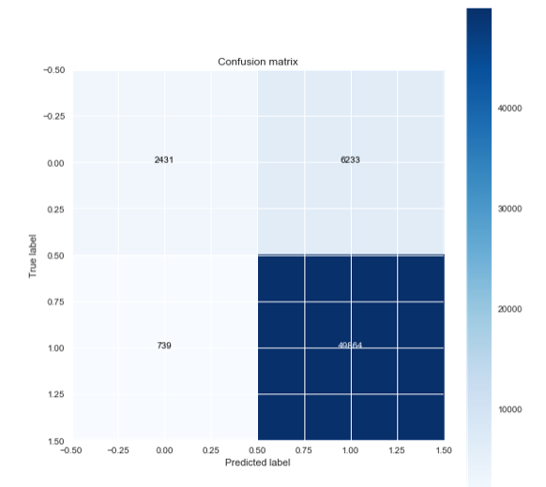
Multinomial NB
Accuracy: 88.2
Misclassification Rate: 11.8
TP Rate: 98.5
FP Rate: 71.9
Specificity: 28
Precision: 88.9
Prevalence: 85.4
Figure 8 TN, FP, FN, TP (clockwise): 2431, 6233, 739, 49864

Slide 17
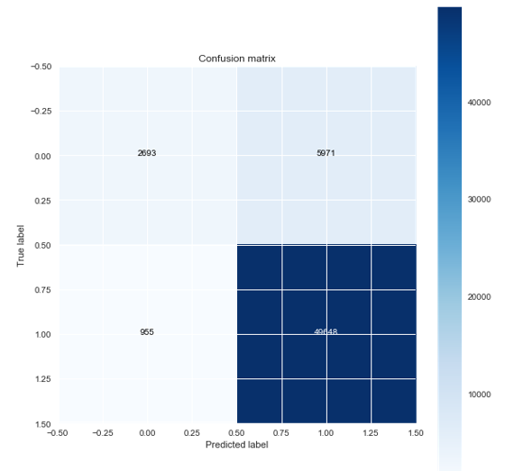
ADA Boost
Accuracy: 88.3
Misclassification Rate: 11.7
TP Rate: 98.1
FP Rate: 68.9
Specificity: 31.1
Precision: 85.4
Prevalence: 85.4
Figure 9 TN, FP, FN, TP (clockwise): 2693, 5971, 955, 49648

Slide 18
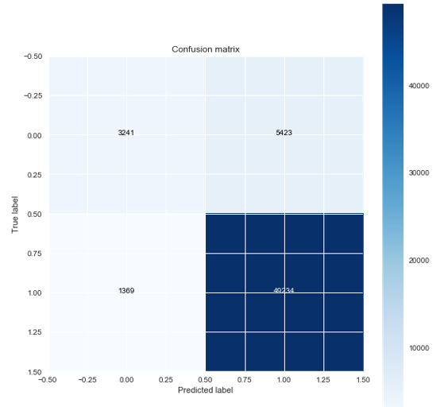
Logistic Regression
Accuracy: 88.5
Misclassification Rate: 11.5
TP Rate: 97.3
FP Rate: 62.6
Specificity: 37.4
Precision: 90.1
Prevalence: 85.4
Figure 10: TN, FP, FN, TP (clockwise): 3241, 5423, 1369, 49234

Slide 19
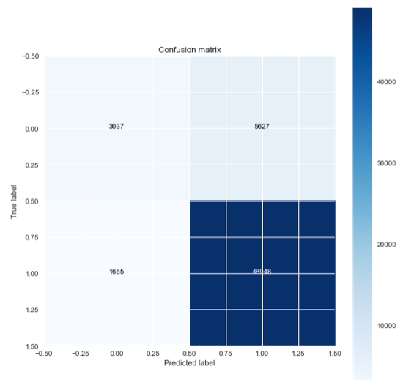
Decision Tree
Accuracy: 87.7
Misclassification Rate:
TP Rate: 96.7
FP Rate: 64.9
Specificity: 35.1
Precision: 89.7
Prevalence: 85.4
Figure 11: TN, FP, FN, TP (clockwise): 3037, 5627, 1655, 48948

Slide 20
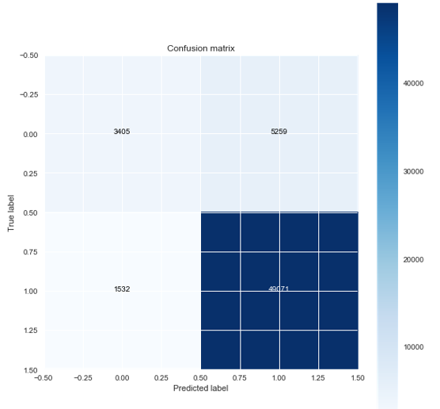
Random Forest
Accuracy: 88.5
Misclassification Rate: 11.5
TP Rate: 97
FP Rate: 61
Specificity: 39.3
Precision: 90.3
Prevalence: 85.4
Figure 12: TN, FP, FN, TP (clockwise): 3405, 5259, 1532, 49071

Slide 21
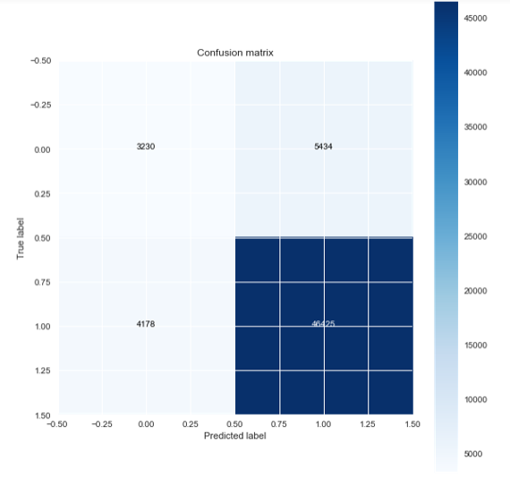
Perceptron
Accuracy: 83.8
Misclassification Rate: 16.2
TP Rate: 91.7
FP Rate: 62.7
Specificity: 37.3
Precision: 10.5
Prevalence: 85.4
Figure 13: TN, FP, FN, TP (clockwise): 3230, 5434, 4178, 46425

Slide 22
Results
Confusion Matrices can come in handy when trying to visually describe the best performance of a classification model
Multinomial NB displayed the highest performance.

Slide 23
Text Blob
The next part of my project was to look at sentiment analysis through TextBlob, a library in Python used for processing textual data
API used for many NLP tasks including sentiment analysis.
Grouped all reviews by product (~18,000) and looked at the vocabulary from all of the reviews for each product.
Assigned a polarity score to each item with negative polarity correlating to negative reviews/vocabulary and a positive polarity corresponding to positive reviews/vocabulary.

Slide 24
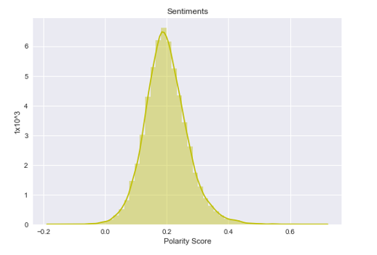
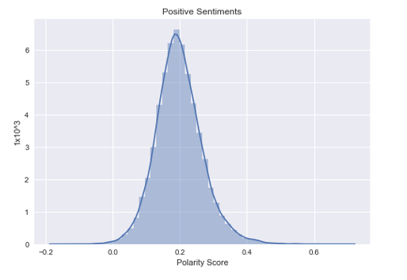
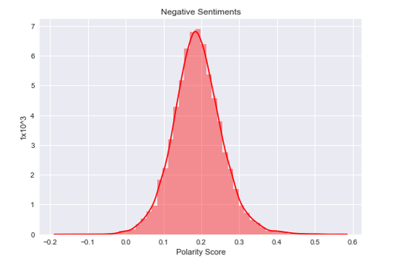
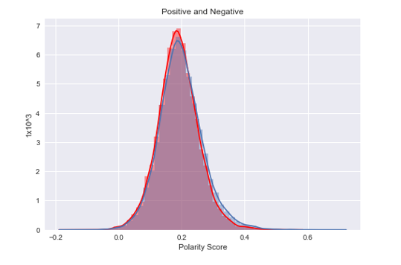
Polarity Score = ~0.19

Slide 25
Results
These two distributions followed a normal curve and found that the two distributions were statistically different
Both groups were more positive than negative since the mean polarity score for both was approximately 0.19
This could be explained by the fact that Amazon typically removes products that are low performing, in order to keep up their reputation.

Slide 26
Potential Next Steps….
Artificial Intelligence
Financial markets
Healthcare framework
With Big Data Deep Learning

